Slide 1
Name | Cameron
Git Hash | 0df3249a3ba0853b8c291e061eccfbd9fc56a0b3
Sprint number | Start date | end date | Work hard rating
3 | 2/5/22 | 27/5/22 | 2/5

Slide 2
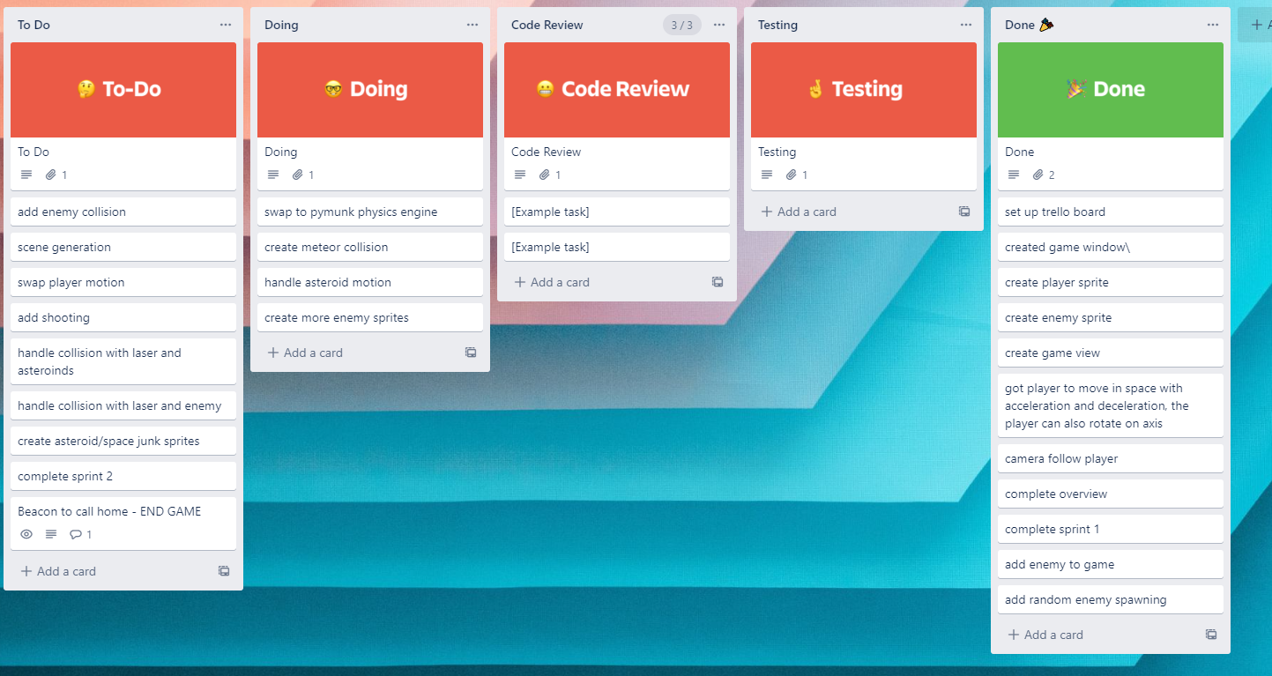
KANBAN board at the start of the sprint

Slide 3
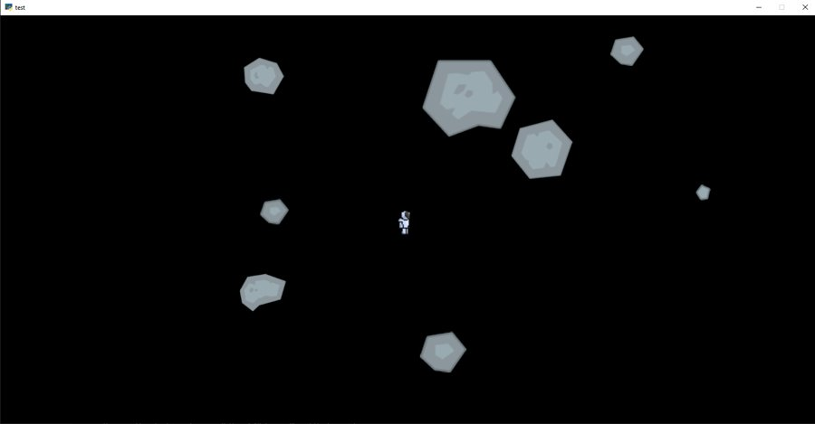
Screenshot of the game at the start of the sprint

Slide 4
Sprint Reflection and summary
Sprint 3 was extended to 4 weeks due to a lack of completed work so we didn't have much work to show for the first 2 weeks
I designed 5 sprites to replace the test meteors which were fuzzy due to how i scaled the sprites
I created an extra file to test the steering AI which were very successful but it still needs a lot of work to be implemented like i need to learn how it interacts with the physics engine and to get multiple steering AI's working
I finished the spawning of enemies so that they spawn off the screen at random locations

Slide 5
Briefly describe other team members contributions
James began implementing the physics engine. The asteroids and players would collide but the forces and masses needed to be tweaked

Slide 6
Major Changes and Achievements Described
enemies spawn of screen in random locations
The "enemy" will seek the mouse, but it does not function with the physics engine and there is only one enemy
Physics engine isn't done but collisions and movement are working so when things collide it is more realistic than a simple physics engine

Slide 7
Brief Description of your testing
To test if the steering functioned as intended i created a file within the repository that had the code which we ran to test values. We found that they went towards the objects we wanted them to follow in the most efficient way while accounting for current velocity, we found it worked and we showed other people like Mr Ward and Anouk and they said it look realistic. Overall after some tuning the steering was moving at a speed and in a way that was vissualy appealing
To test the physics engine we would run the game and observe collisions happening. They collided smoothly but due to the spawning code the map became overpopulated

Slide 8
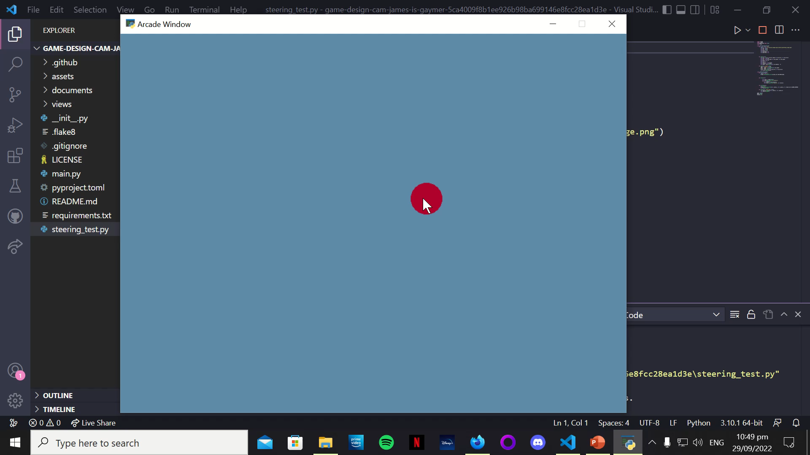
Link to testing results/tables

Slide 9
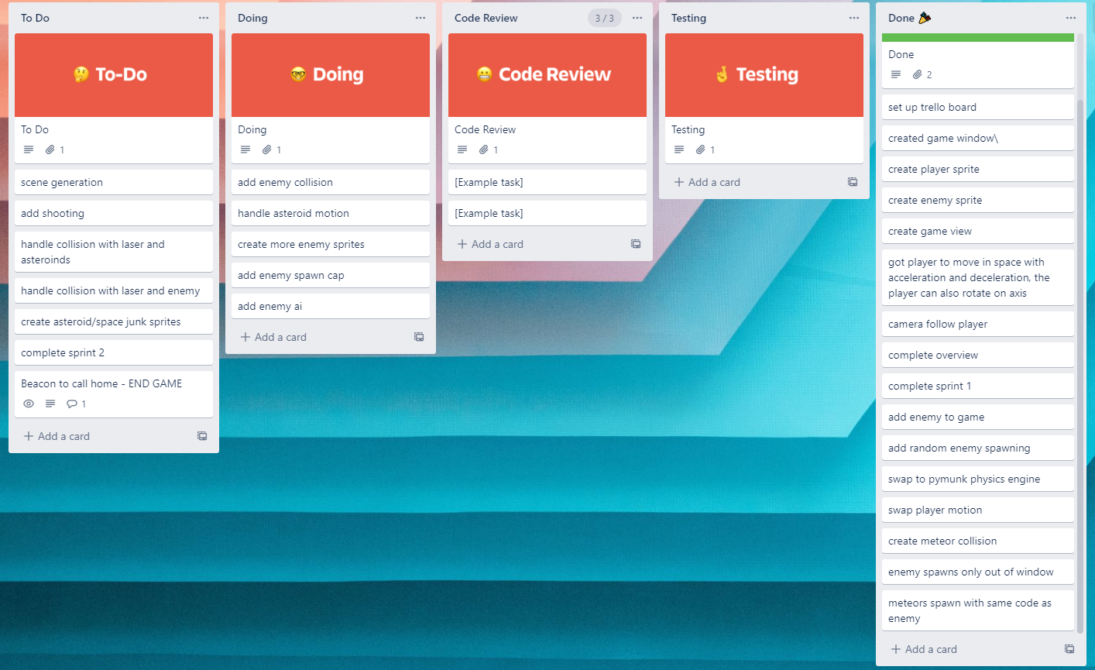
KANBAN board at the end of the sprint

Slide 10
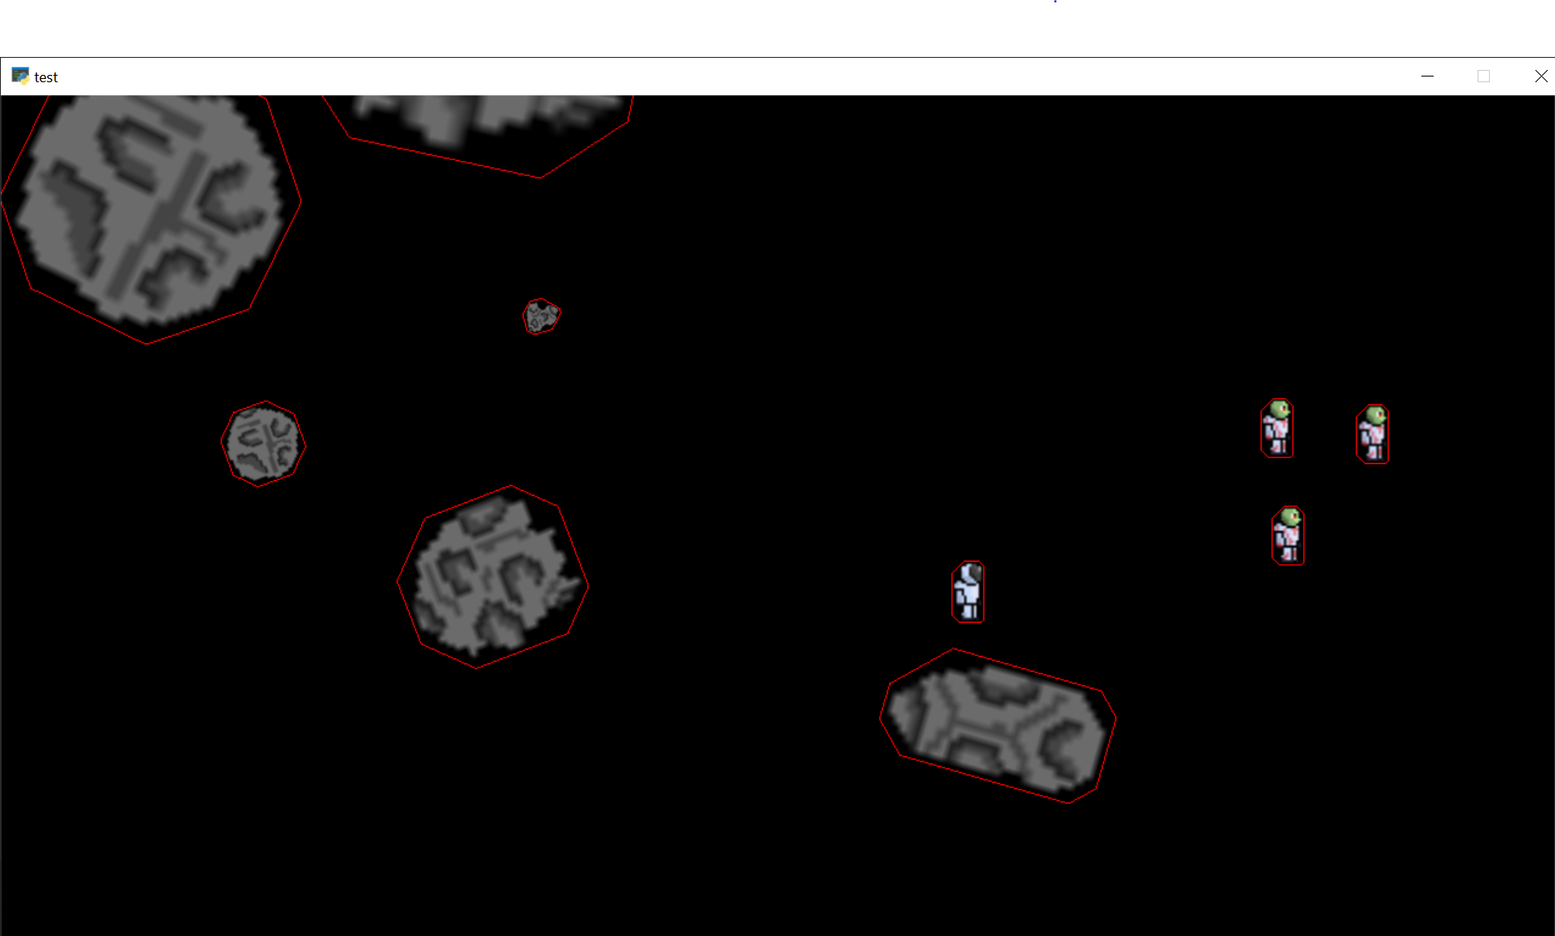
Screenshot of the game at the end of the sprint

Slide 11
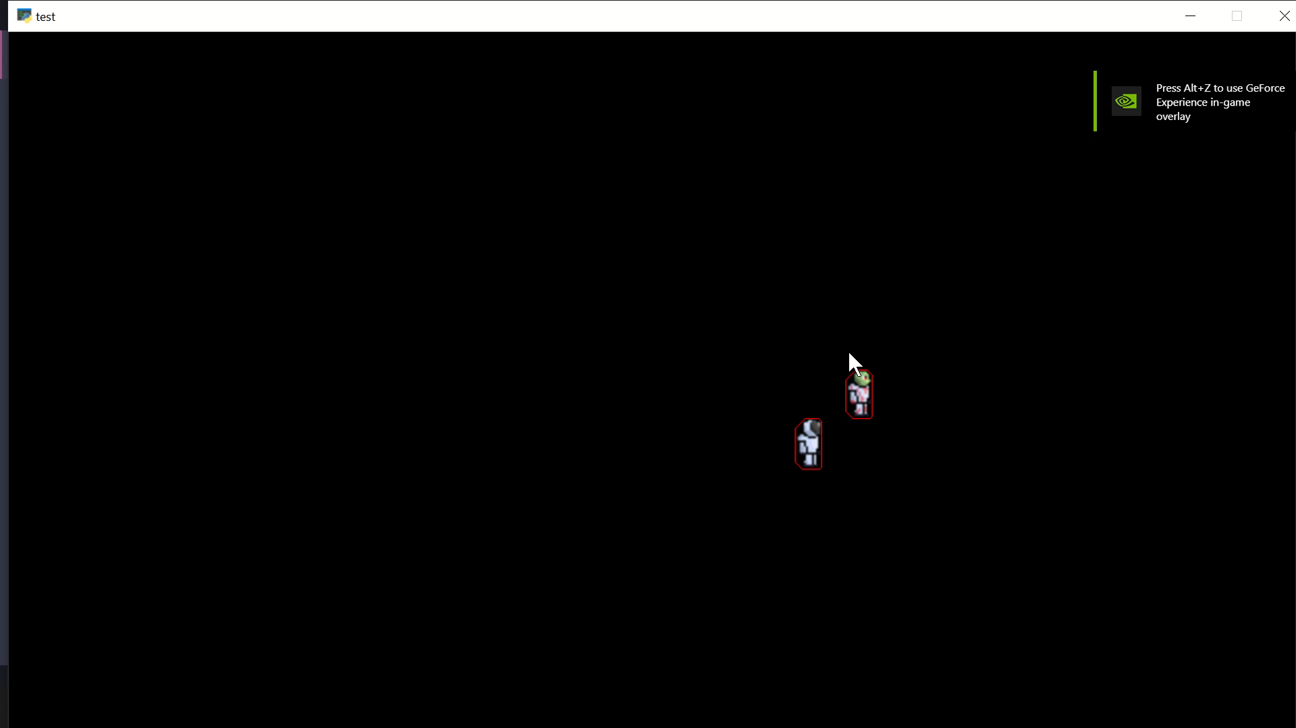
Video of the game at the end of the sprint

Slide 12
Notes for next time, future improvements
I want to have the ai to work with multiple enemies with a pymunk physics engine so that i can implement in game
I would like to start implementation next sprint but i will probably need to speed up my progress or not run into many problems

